Slide 1
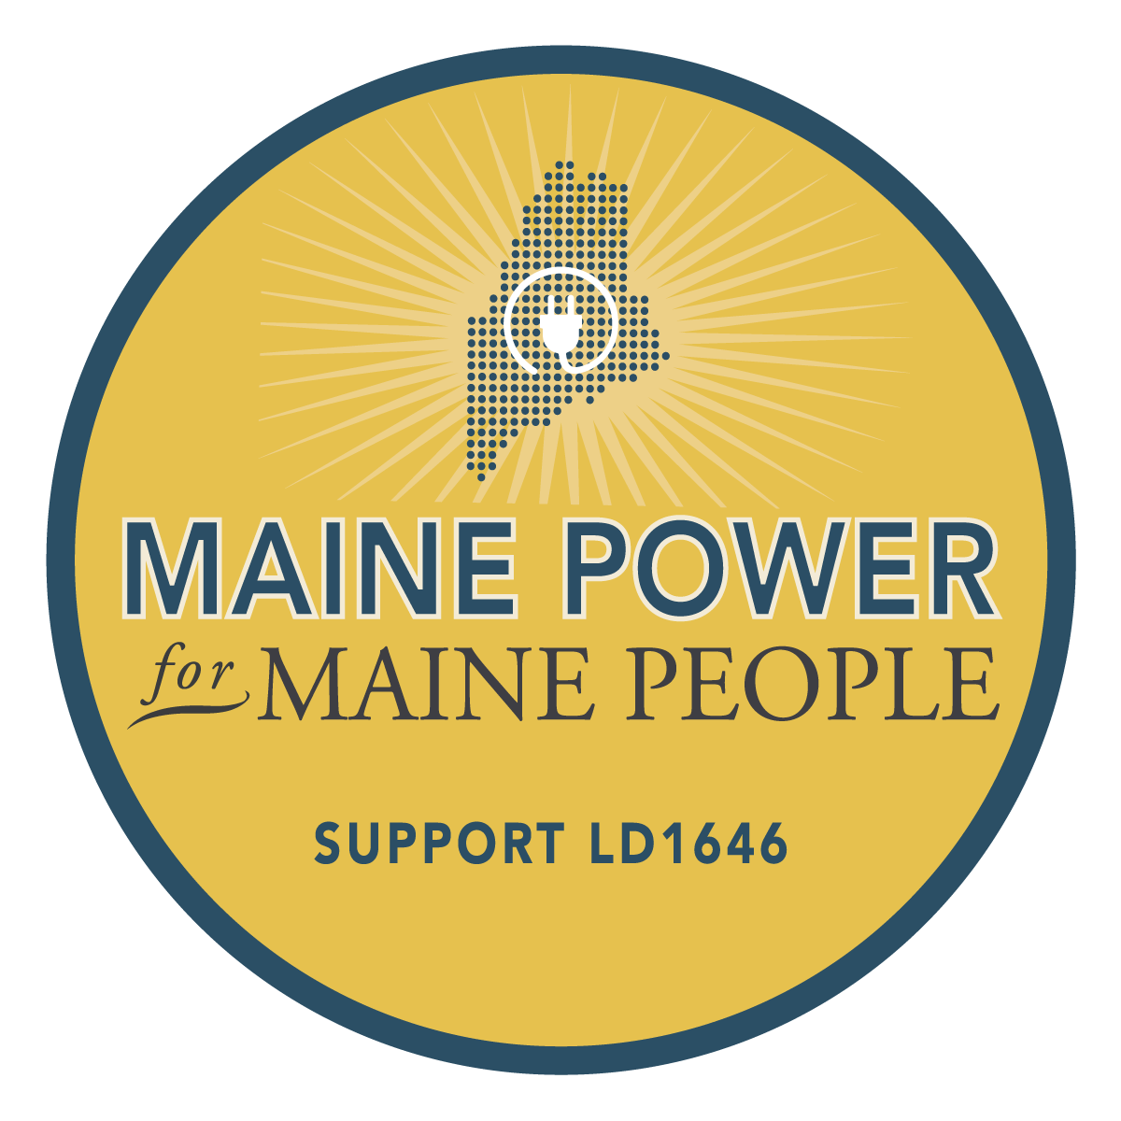
Consumer Owned Utility
for Maine Climate Action

Slide 2
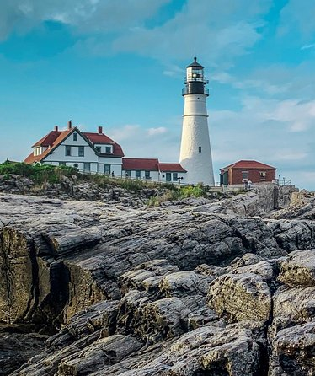
Maine
has set ambitious goals to tackle
climate change.

Slide 3
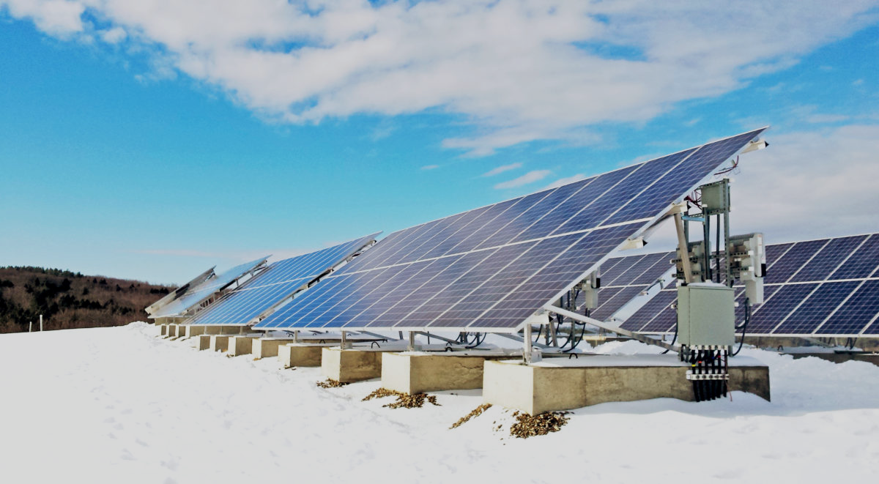
We need to transform our energy
system towards resilient renewables
Notes:
Maine wants to achieve net zero by 2050. To do so means transforming how Maine’s energy system is run

Slide 4
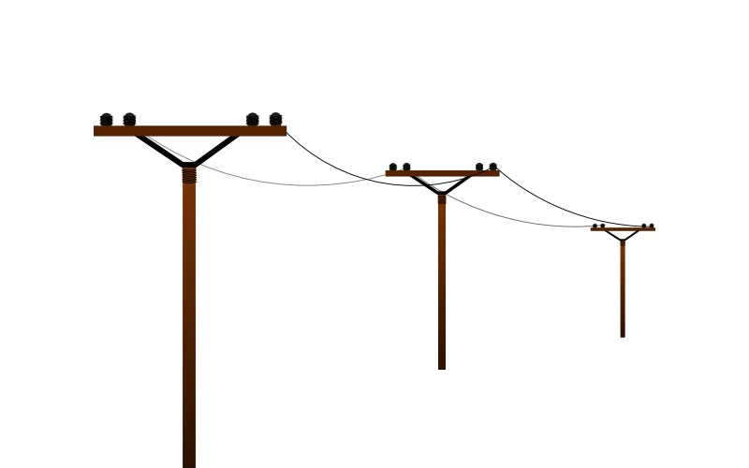
The Energy Grid:
Core to Maine’s energy future
3X
more
electric power
Notes:
Moving towards a renewably-powered energy system means transforming gas into electric in our homes, moving towards electric transport and cars, this means we will need three times more electric power than we currently use!
Plus, we need major investments in our antiquated grid so that it can handle solar and wind, and manage the new flows of decentralized renewable energy
This makes control over the energy grid VITAL to Maine’s ambitious energy goals

Slide 5
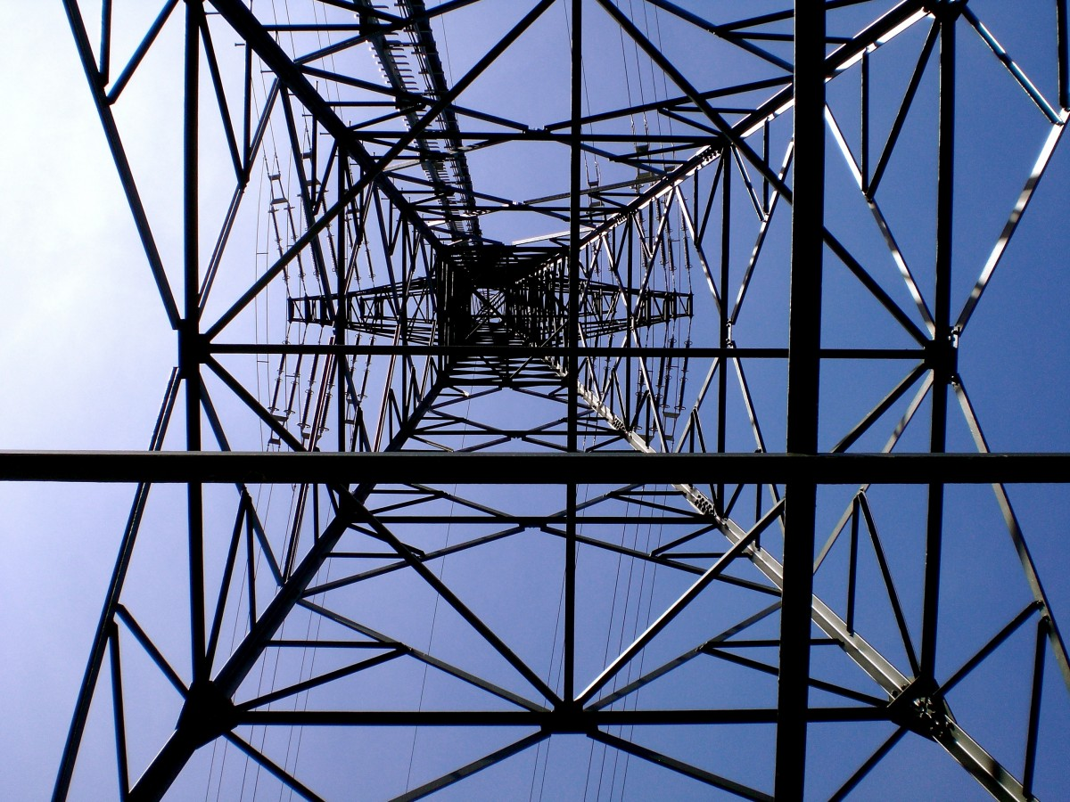
We Need a Consumer Owned Utility to Reach Our Climate Goals
Notes:
To actually achieve these ambitious goals we need a consumer owned utility.

Slide 6
Notes:
That’s why we are supporting legislation to create a consumer owned utility in Maine

Slide 7
Maine Power Delivery Authority
A consumer-owned and controlled non-profit utility that distributes energy across Maine.
**Except for areas already served by other consumer owned utilities.

Slide 8
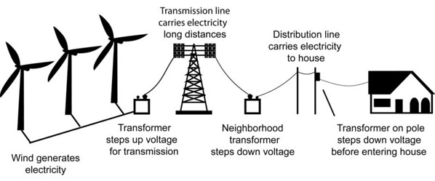
Maine Power Delivery Authority
Reliable, Renewable, and Resilient Grid

Slide 9
Benefits of Consumer Ownership

Slide 10
Maine Power Delivery Authority
Clean Energy
Local Economy
Consumer Control

Slide 11
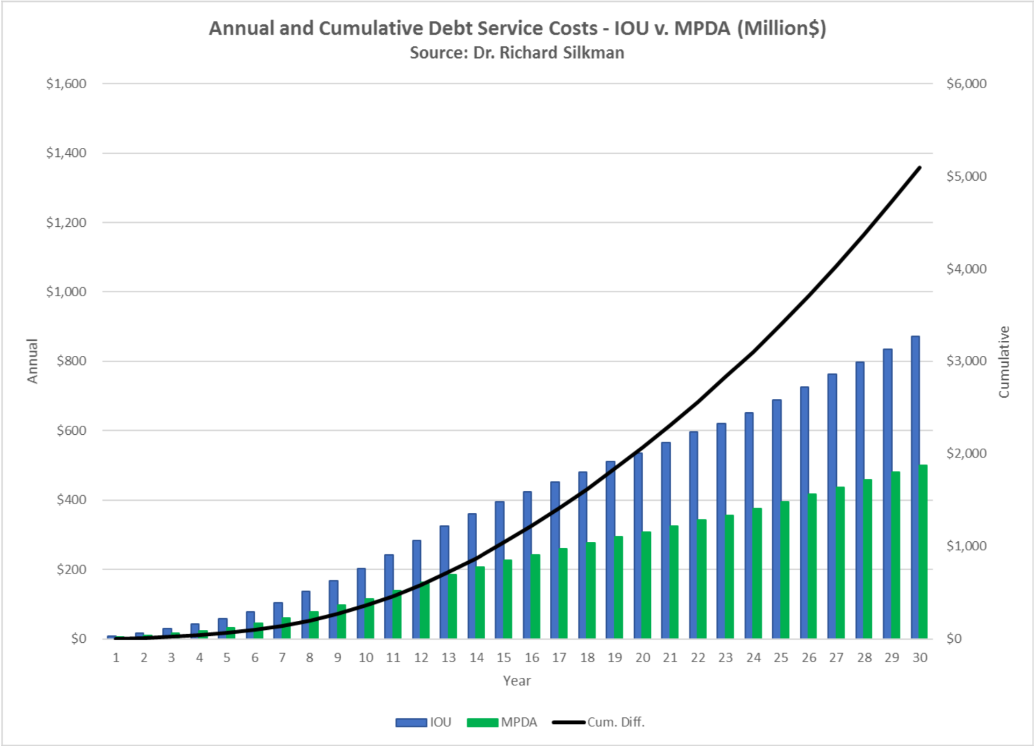
$5 BILLION
in savings
Cheaper Cost
Notes:
In the next few years, our grid needs between $10 and $15 billion in investments so we can have a clean and resilient energy grid and electrified economy
Not only would CMP and Emera have to borrow money for those investments at 8% or more, they also take a cut for their own revenues!
In comparison, as a nonprofit consumer owned utility, we would get access to much cheaper financing (around 3%) and all revenues that are made are either reinvested back into the grid or into local/state services.
Over 30 years, energy expert Dr. Richard Silkman expects Maine to save $5 billion

Slide 12
Consumer Ownership of Utilities is Widespread
Notes:
Consumer ownership isn’t some crazy idea. In fact there are examples of it across the United States.

Slide 13
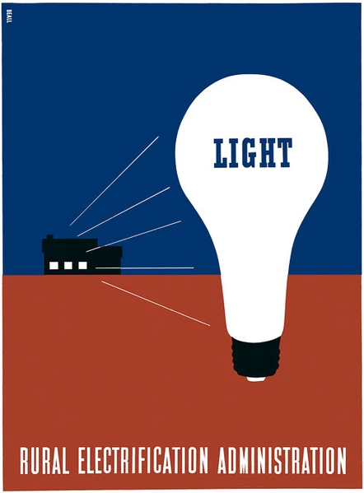
1 in 3
Americans get their energy from consumer-owned utilities
Notes:
Just about one in three people receive their energy from consumer owned utilities.
Here’s a flyer from the Rural electrification Administration that helped electrify rural America from 10 to 90% in the 1930s all by allowing farmers and rural residents to band together to create their own consumer owned utilities. It was one of the most successful post-depression programs.

Slide 14
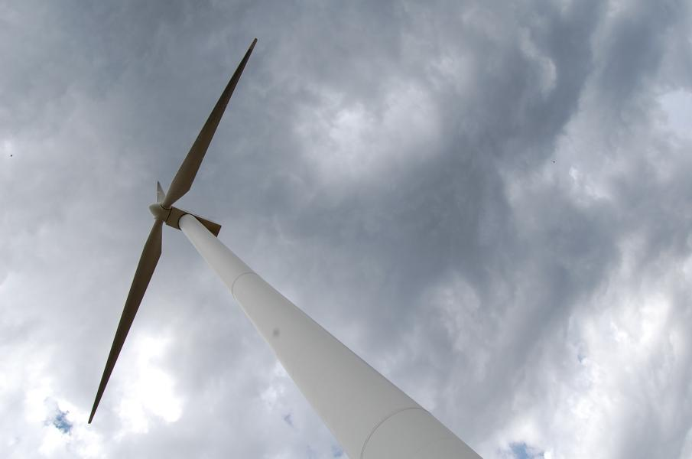
“Our electric prices do not include a profit. That means Nebraska’s utilities can focus exclusively on keeping electric rates low and customer service high. Our customers, not big investors in New York and Chicago, own Nebraska’s utilities.”
Notes:
Across the United States there are examples of consumer ownership-- from small towns to entire states.
The entire state of Nebraska is run off of public power. This has kept rates affordable and has given them a lot of local control. They pride themselves on not being beholden to multinational corporations and have been able to provide high quality, affordable power.
In New York-- the New York Power Authority provides in-kind electricity to public buildings and important public infrastructure like the subway. They also provide important in-kind engineering to the state.

Slide 15
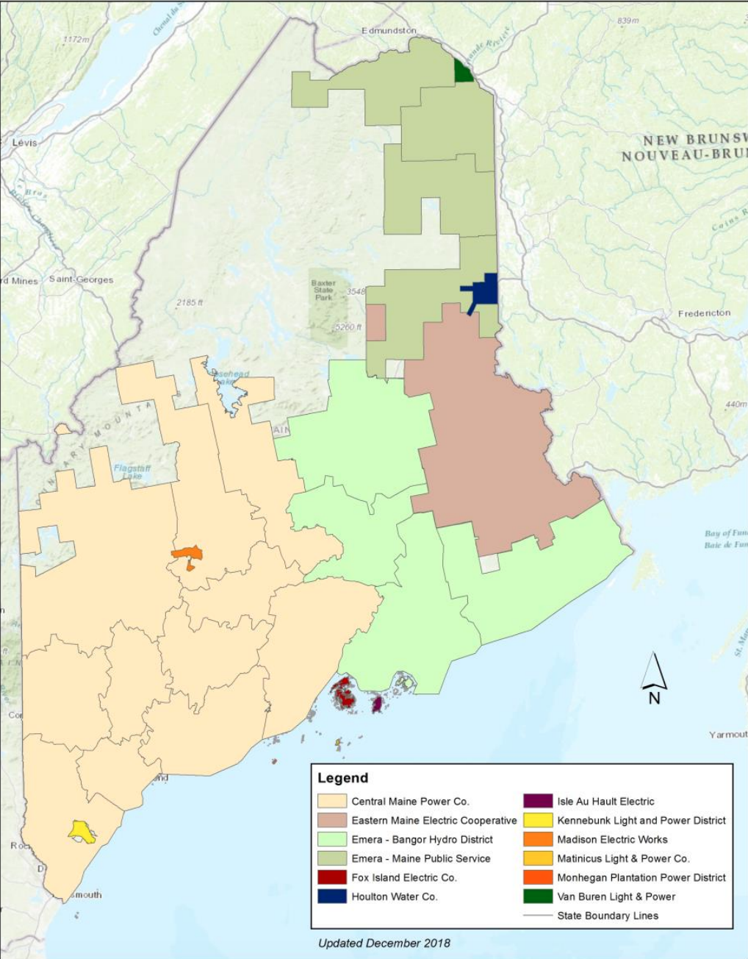
Maine Already Has
Consumer Owned Utilities
18%
cheaper rates in consumer owned territory
Notes:
Already there are examples of consumer ownership in Maine - 97 communities in Maine are served by 9 consumer-owned utilities and their consumers pay 18% less than people who are served by Emera or Central Maine Power.

Slide 16
Examples of Transitions to Consumer Ownership
Notes:
There are examples across the country of cities and states fed up with their investor owned utility. We are far from alone in this fight. For example, in the states of California and New York there is active legislation like ours to transfer ownership away from private interests and into the hands of consumers. At the city level, places like Pueblo, CO; Chicago, IL, and Boston, MA are all thinking about consumer ownership.
But has this been done before? Have cities or states gotten out of their contracts with corporate monopoly utilities? The answer is YES!

Slide 17
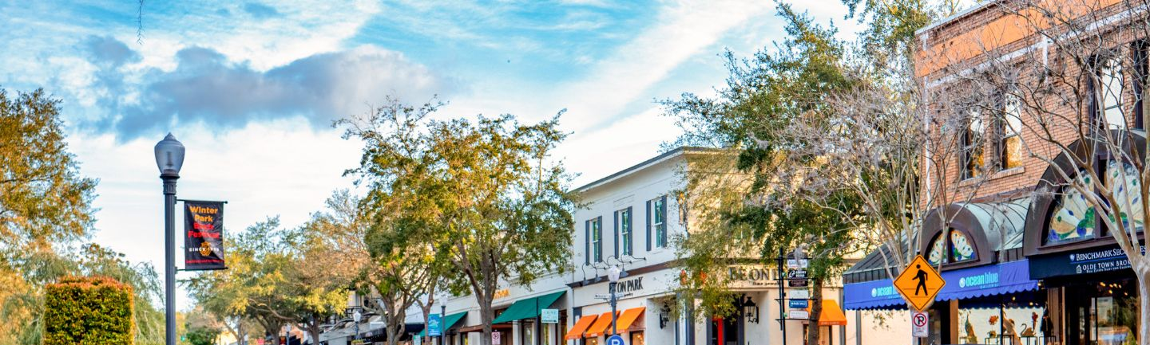
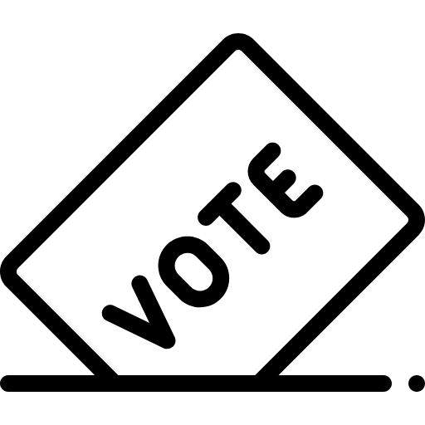
Winter Park, FL
2005
"We proved to them the little guys can do it just like they can."
Jerry Warren, Electric Utility Director
Outcomes:
69% of residents voted in favor of consumer ownership
Repaid acquisition cost in under 10 years
Dramatically increased reliability, even with bigger storms in FL
Notes:
Much like in Maine, residents of Winter Park, FL were sick of the major reliability problems with Progress Energy, the IOU, and wanted to stop the constant outages. Plus, it was sick of Progress Energy making money off a poorly-run energy system. That’s why they decided to take it over.
Winter Park Florida finalized its transition to consumer ownership in 2005.
Voter turnout was the highest they had seen since the 1980s and the city overwhelmingly voted in favor of consumer ownership. 69% of people voted for consumer ownership
This did not come without opposition-- the IOU Progress Energy spent half a million dollars to stop the municipalization (some from ratepayer money!)
The city was able to pay back the costs of buying the system within 10 years (it borrowed directly from the city’s general fund)
Since the transfer of ownership, reliability has improved dramatically-- in large part from burying wires-- and they were better equipped to handle the increasing number of storms hitting FL. They were able to also invest in broadband when they buried the wires, providing a new and important service to the city

Slide 18
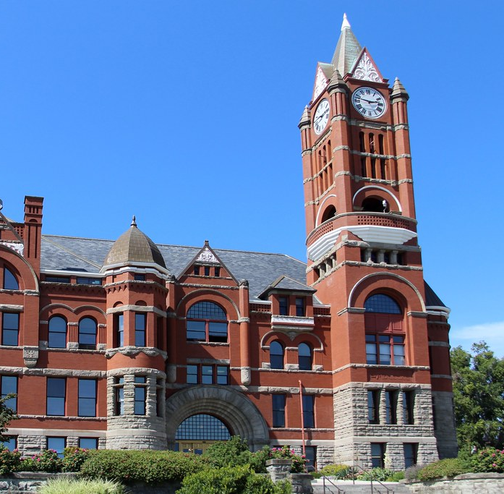
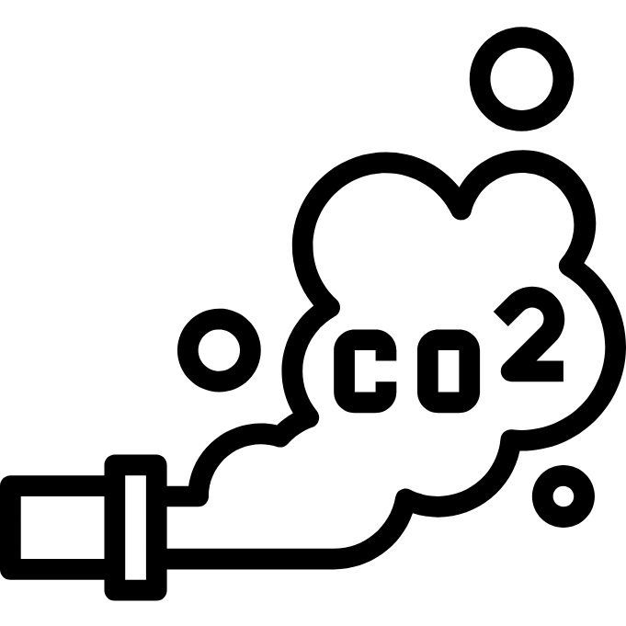
Outcomes:
Jefferson Co, WA
2008
Lowered rates, w/ reduced rates for low income households
Increased local jobs
Helped decarbonize the energy system
Notes:
Jefferson County, Washington wanted to make energy more affordable and tap into more clean energy through the network of consumer-owned utilities, particularly the federally-owned Bonneville Power Administration. After transitioning to full consumer ownership, the city saw outcomes on the initial promise, including:
Increased local jobs from skeletal staff of 3 to over 30 locally
Low income credits for seniors or qualifying homes, including lowering costs for their sewers
97% carbon free, largely coming from their access to lower cost hydro through their preferred relationship with the Bonneville Power Authority (accessible to coop and public power) - the IOU had 60% from coal and natural gas

Slide 19
Outcomes:
the case of waterdd
Enabled Community Advisory Councils for direct input
Increased investments in green infrastructure
Pittsburgh, PA
2015
Secured lower-cost municipal bonds for investment
Notes:
Much like energy, water is a core service in our economy. And similarly, much of our water infrastructure IS consumer owned. But some cities’ water systems have been privatized over the years like Pittsburgh.
The private multinational Veolia eroded its relationship with the the Pittsburgh public as they failed to invest in the infrastructure, laid off staff, and allowed more pollution. In particular, it may be culpable for the high levels of lead currently in the water.
After transferring back to consumer ownership:
Enabled community advisory committees related to water quality, water affordability, and stormwater that allow for increased community participation
Implemented its city wide “Green First” plan to build better stormwater infrastructure that leverages the natural environment for multiplicative benefits
Lower-cost municipal bonds for investment at 4% instead of 8% or as high as 12-15% with a private utility

Slide 20
The Problem with Central Maine Power

Slide 21
Central Maine Power
Poor Reliability
Bad Billing Practices
No Climate Vision
Commitment to Profit,
Not Mainers
Notes:
This is a Picture of Iberdrola headquarters in Bilbao, Spain
CMP has come under fire for erroneous billing practices - dramatically overcharging low-income Mainers already disproportionately burdened by high energy bills.
At the same time, the multinational owners of its parent company based in Spain say that CMP has “doubled” its net income in the past 10 years
Ranked worst in the nation for customer satisfaction
Some of the worst reliability in the country. Over 2,600 minutes of lost energy per customer.

Slide 22
Spain is happy, but how about Maine?
“Let’s forget about what has happened. We just need to move on. We are very happy with CMP.”
“CMP has doubled its net income and earnings... in the past 10 years.”
-Iberdrola Executive, 2/20/2020
Notes:
“Before CMP was part of Avangrid, money made was invested back into the company. When parent Avangrid became public, it shared dividends with shareholders”
“CMP has doubled its net income and earnings... in the past 10 years.”
https://bangordailynews.com/2020/02/20/business/cmps-spanish-owner-wants-to-move-past-problems-exec-says-during-maine-visit

Slide 23
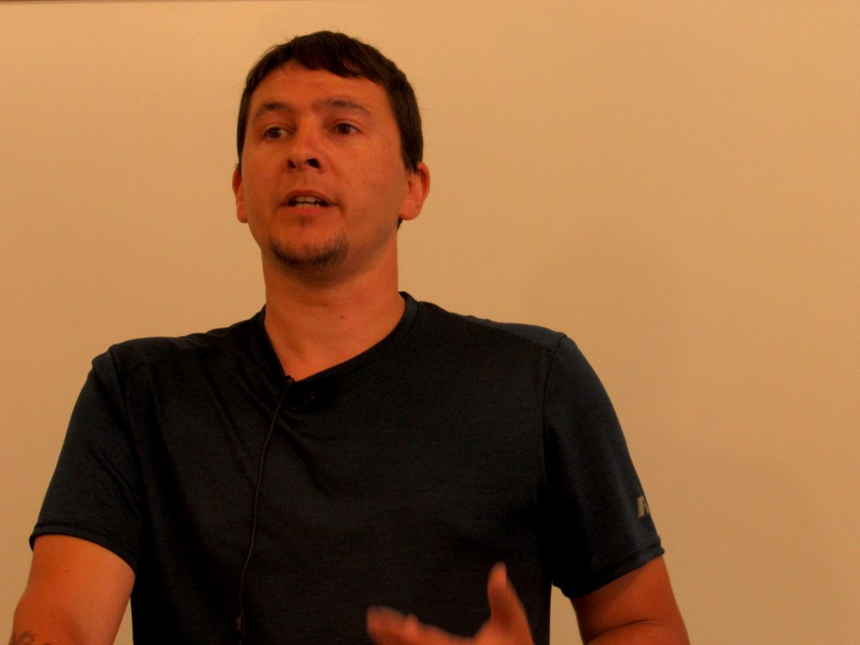
“
No one wanted to pay more for electricity than their mortgage [...] I ended up having to file for bankruptcy.
“
Rob Du Paul, CMP Customer
Notes:
Quote from a hearing on the rate increase

Slide 24
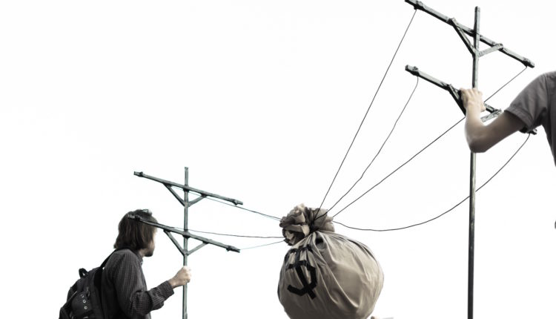
Major Political Influence
Notes:
Going against Central Maine Power will not be easy
Investor owned utilities have major political power that they have weaponized against campaigns like this one
They’ve also rolled back commitments to climate and forced through projects that communities are against

Slide 25
What You Can Do

Slide 26
LD 1646
Support Legislation for the Maine Power Delivery Authority

Slide 27
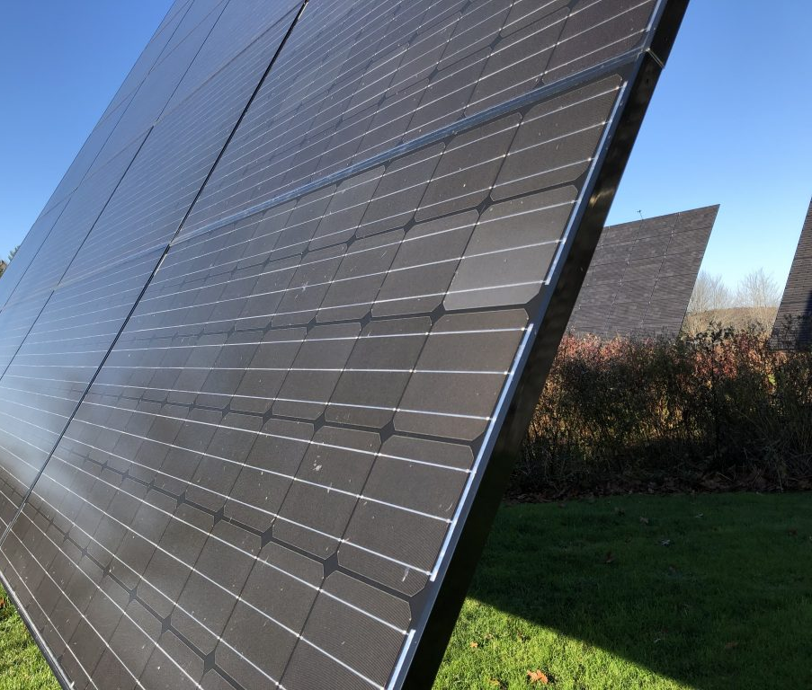
CALL
Your local Representative
and Senator
Information on social media and w/friends
SHARE
#OwnTheGrid
#MainePower4MainePeople
Opinion pieces or letters to the editor
WRITE

Slide 28
Thank you!
For more information, contact us at info@mainepower4mainepeople.org

